Slide 1


ALY 6080:Final Presentation
Syed Faizan
Christiana Adjei
Emelia Doku
Vraj Shah
Shicheng Wan
Pravalika Sorda
Under the supervision of Dr. Jay Qi, PhD.

Slide 2
Demographics, Housing and Financial Stability in the Toronto GTA: Trends and actionable insights
Syed Faizan
Christiana Adjei
Emelia Doku
Vraj Shah
Shicheng Wan
Pravalika Sorda
Under the supervision of Dr. Jay Qi, PhD.

Slide 3

About United Way Greater Toronto (UWGT)
United Way Greater Toronto is dedicated to improving the lives of those in need by mobilizing communities for lasting social change

Slide 4

Overview of Population and Demographics in the Greater Toronto Area
Analyzing population and migration trends across the Toronto GTA, other cities, the age groups, and ethnic demographics to derive actionable insights.

Slide 5
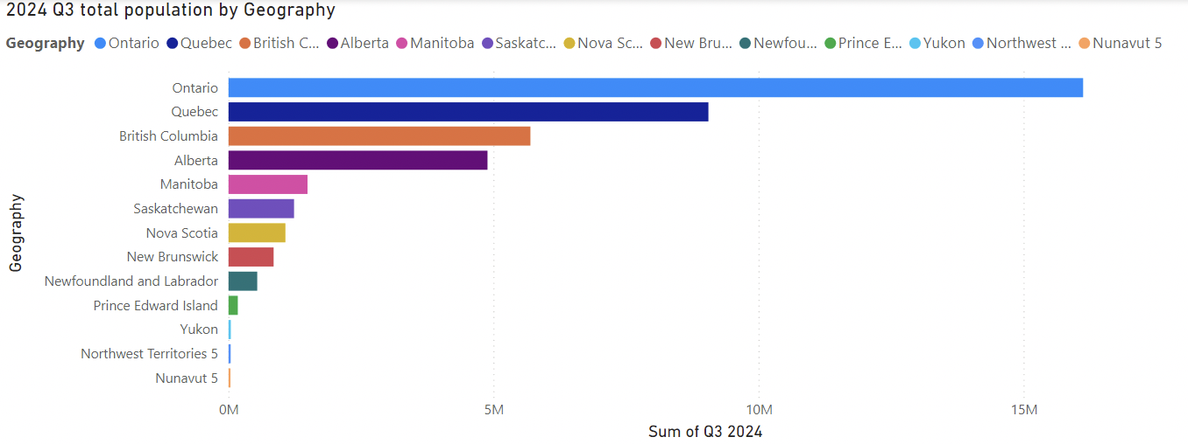
Population by Canadian Province
Data Source: Statistics Canada.
Table 17-10-0009-01 Population estimates, quarterly
The bar chart shows the population across various provinces.
Ontario leads significantly, followed by Quebec and British Columbia.
Northwest Territories, Yukon, and Nunavut have the smallest population sums.
Mention the substantial gap between top provinces (e.g., Ontario) versus the others.

Slide 6
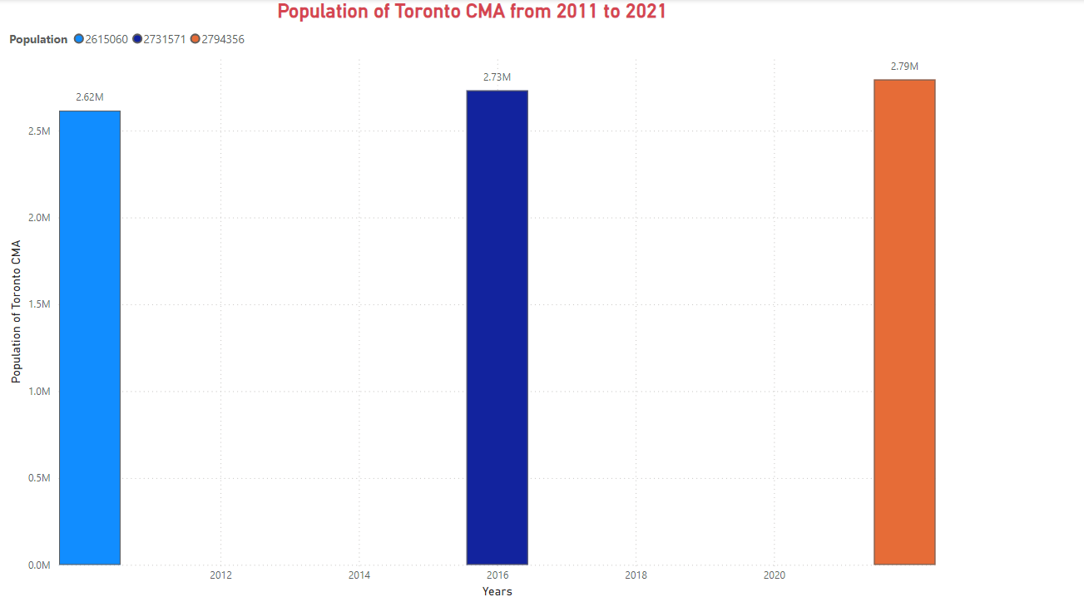
Population of Toronto CMA from 2011 to 2021
Data Source : Statistics Canada. 2021 Census of Population.
Toronto CMA's population shows steady growth, increasing from 2.62M in 2011 to 2.79M in 2021.
The consistent rise in population highlights the region's attractiveness for migration and urban development.
Actionable Insight: Expand housing, infrastructure, and social services to accommodate growing population demands in Toronto CMA effectively.

Slide 7
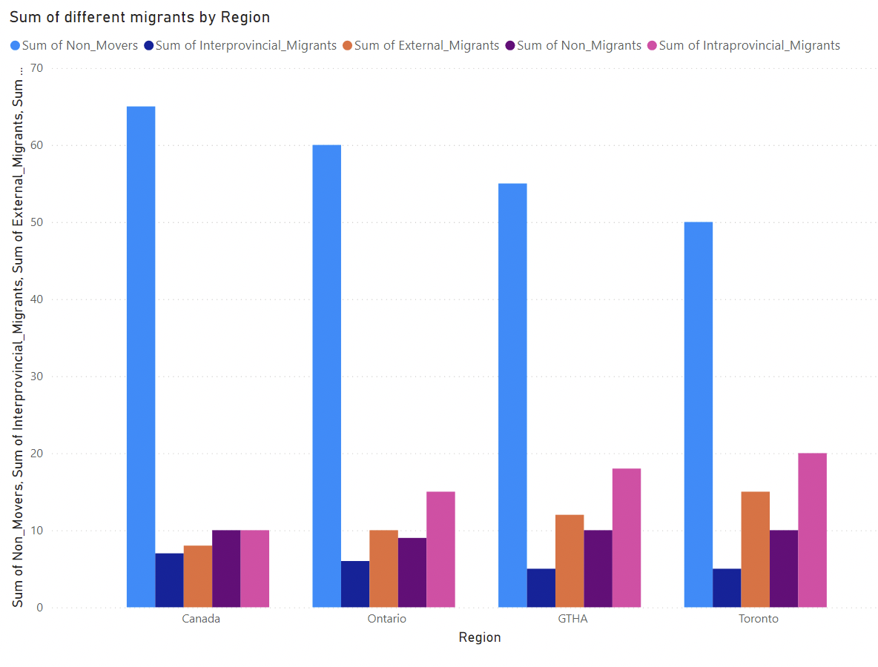
Migration and Mobility Patterns by Region
Data Source: Internal migration: Overview, 2016/2017 to 2018/2019
Non-Movers as Majority: Non-movers dominate regions like Ontario.
Focus on retaining residents with better amenities and services.
Urban Migration: Toronto and GTHA attract high external migration.
Enhance settlement programs, housing, and job access for newcomers.
Intra-Provincial Migration: Smaller but steady contributions.
Improve regional transport and connectivity to boost economic activity.

Slide 8
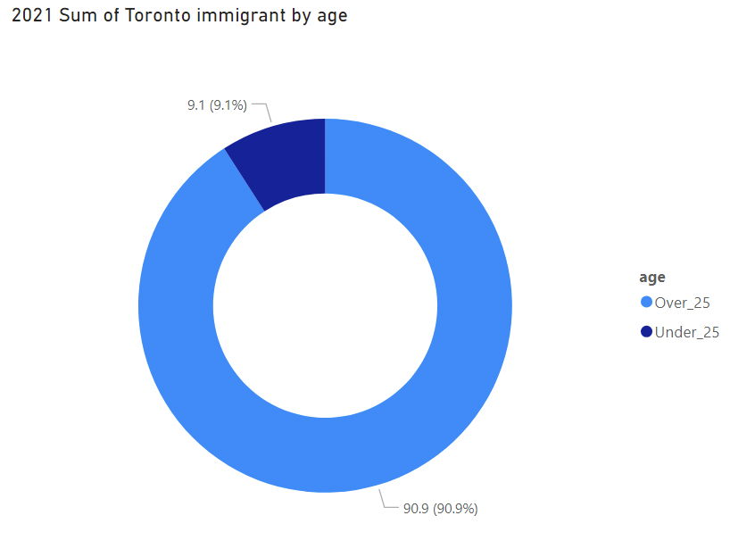
Age Distribution of Immigrants in Toronto
Data source: Migration by age Estimates of the components of international migration, by age and gender, annual
Key Insight: 90.9% of immigrants are aged over 25, with only 9.1% under 25, indicating an aging immigrant population.
Challenges: This demographic trend suggests potential labor shortages and increased reliance on social services, healthcare, and retirement support.
Actionable Focus: Policymakers must develop strategies for workforce rejuvenation and prepare infrastructure to support aging immigrant communities.

Slide 9
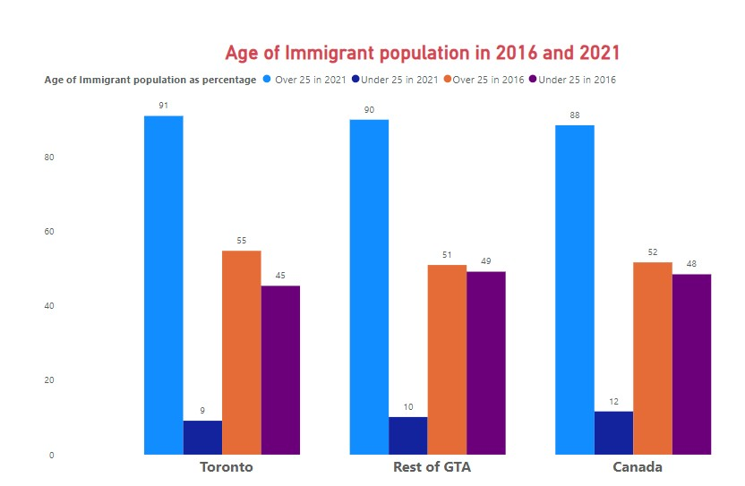
Age of Immigrant population in 2016 and 2021
Youth Decline: The under-25 immigrant population has decreased since 2016.
Consistent National Trend: Similar patterns are observed across Toronto, GTA, and nationwide.
.
Older Immigrant Demographic: In 2021, over 25-year-olds constitute the majority of immigrants in Toronto (91%), the GTA (90%), and Canada (88%).
Data source: Migration by age Estimates of the components of international migration, by age and gender, annual

Slide 10
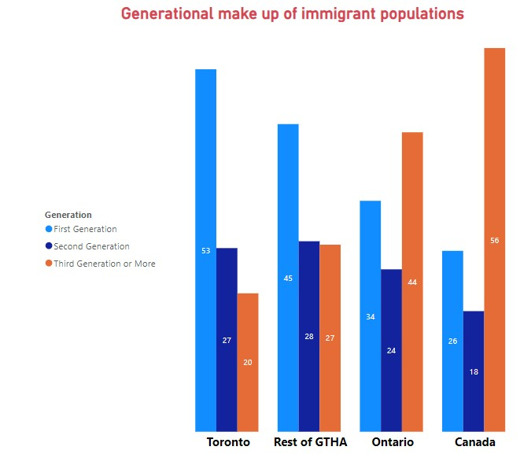
Generational Makeup of immigrant populations
Toronto and the GTHA have a higher percentage of first-generation immigrants, reflecting recent immigration trends in urban centers.
Canada has a larger proportion of third-generation or more immigrants, highlighting long-term immigration and established communities.
Actionable Insight: Develop policies and programs to support first-generation immigrants in Toronto and GTHA, while fostering inclusion in long-established communities.
Data source: Migration by age Estimates of the components of international migration, by age and gender, annual

Slide 11
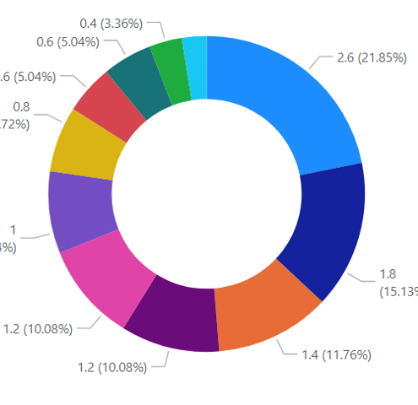
Estimated Population by Racialized Group in Toronto GTA 2021
Diverse Demographics: South Asian (21.85%) and Chinese (15.13%) communities are the largest racialized groups in Toronto, reflecting the city’s multicultural nature.
Key Insights: Filipino (11.76%) and Black (10.08%) groups follow, highlighting the representation of various ethnic communities.
Action Points: Insights from these demographics can guide targeted policies, inclusive community programs, and culturally sensitive initiatives.
Statistics Canada. Table 17-10-0146-01 Projected population by racialized group, generation status and other selected characteristics (x 1,000)

Slide 12
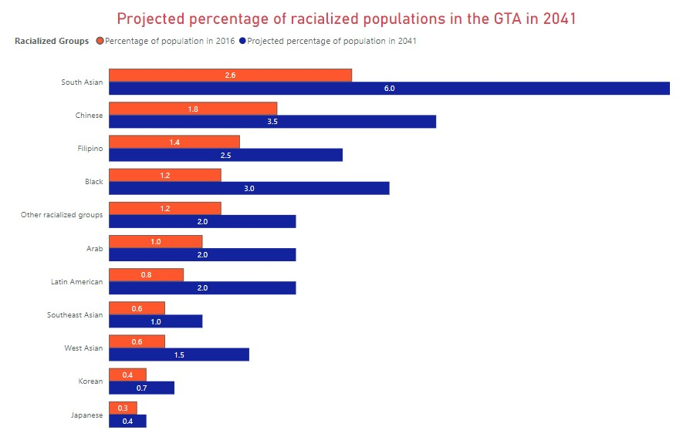
Projected Racialized groups population in 2041
Growing Diversity: South Asian, Chinese, and Filipino populations will significantly grow, shaping Greater Toronto's multicultural landscape by 2041.
Actionable Insight: Strengthen inclusive policies and multicultural programs to support diverse communities and address unique socio-economic challenges effectively.
Statistics Canada. Table 17-10-0146-01 Projected population by racialized group, generation status and other selected characteristics (x 1,000)

Slide 13
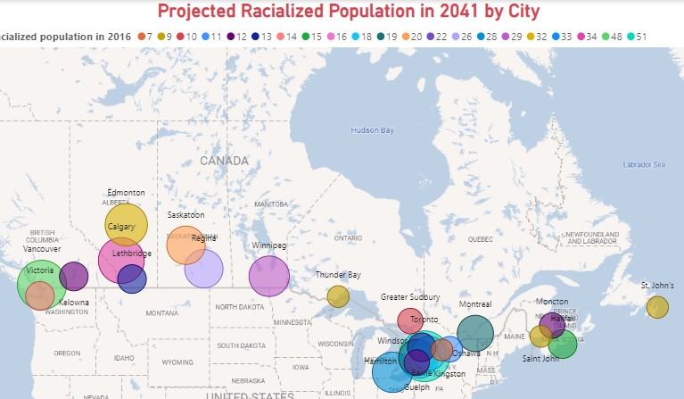
Projected Racialized population in 2041
Significant Growth: Many cities, including Toronto, Vancouver, and Calgary, are projected to see substantial increases in racialized populations by 2041.
Regional Variations: The proportion varies widely across cities, reflecting diverse demographic trends.
Historical Context: The map includes estimated racialized population percentages from 2016 for comparison.
Statistics Canada. Table 17-10-0146-01 Projected population by racialized group, generation status and other selected characteristics (x 1,000)
.

Slide 14
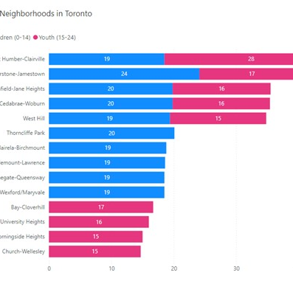
Most Youthful Toronto Neighborhoods
Youth-Centric Neighborhoods: West Humber-Clairville and Mount Olive-Silverstone-Jamestown show the highest proportions of children (0-14) and youth (15-24), making them focal points for targeted initiatives.
Key Insight: These areas represent a significant portion of Toronto’s young population, emphasizing their importance in planning youth engagement programs.
Actionable Opportunities: Investment in after-school programs, sports facilities, and community centers can significantly enhance support for youth in these neighborhoods.
Statistics Canada. Table 17-10-0009-01 Population estimates, quarterly

Slide 15
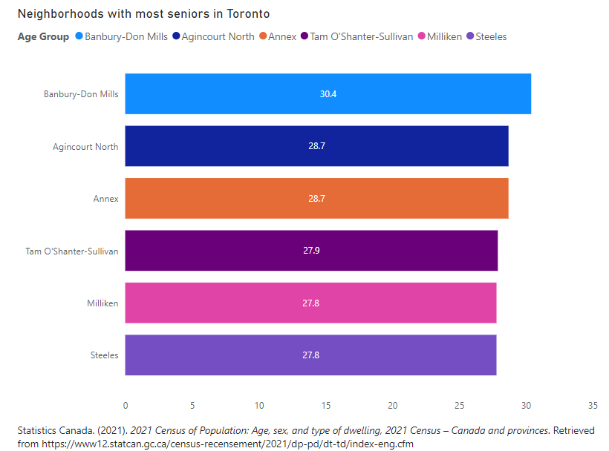
Toronto Neighborhoods with most seniors
Key Insight: Banbury-Don Mills leads with the highest proportion of seniors (30.4%), highlighting it as a significant area for senior-focused policies and services.
Top Neighborhoods: Other notable neighborhoods include Agincourt North and Annex, both with approximately 28.7% senior population.
Policy Implication: These areas require targeted infrastructure, healthcare, and social support tailored to aging demographics.
Statistics Canada. Table 17-10-0009-01 Population estimates, quarterly

Slide 16
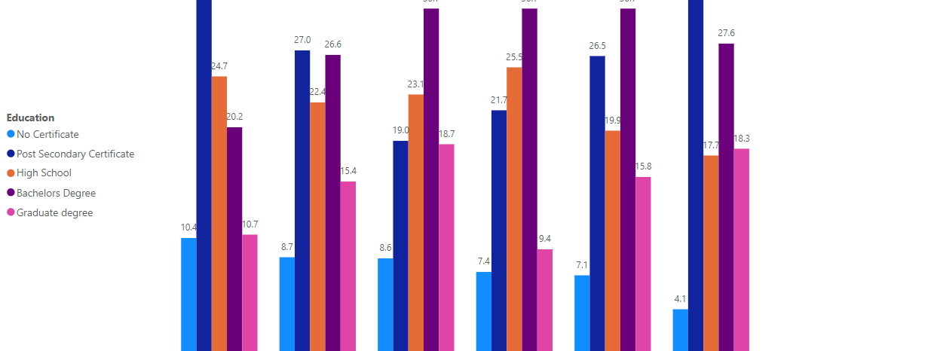
Education in the Toronto populace
Educational Attainment Variance: High school education has the highest share across regions, while graduate degrees show a lower but consistent presence.
Lower Certificate Attainment: The percentage of individuals without certificates remains significant, indicating gaps in formal education access or completion.
Actionable Insight: Strengthen adult education programs, promote access to post-secondary education, and improve skill-development initiatives in underserved areas.
Statistics Canada. (2021). Highest level of education attained, age groups and sex for the population aged 15 years and older in private households of Canada, provinces and territories, 2021 Census

Slide 17
Summary of Demography in Toronto, GTA
Steady population growth in Toronto CMA, increasing from 2.62 million in 2011 to 2.79 million in 2021.
Migration trends highlight urban migration dominance and a decreasing youth demographic among immigrants.
Diverse racialized groups are projected to grow significantly by 2041, particularly South Asian and Chinese populations.
Action Points:
Expand infrastructure and social programs for diverse and growing communities.
Focus on policies to support youth engagement and address aging demographics.

Slide 18

Overview of the Financial Stability in GTA
Examining financial stability indicators in the Greater Toronto Area, including income inequality, wage gaps, low-income prevalence, unemployment, and social assistance effectiveness.
This analysis aims to provide insights into economic well-being, identify vulnerable populations, and highlight potential areas for policy intervention to enhance overall financial stability in the region.

Slide 19
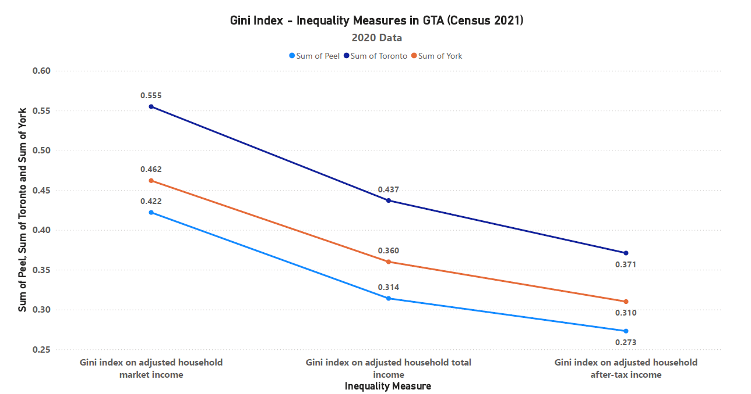
Gini Indices – Inequality Measures in GTA (Census 2021)
The Gini index, a measure of income inequality, ranges from 0 to 1, with 0 representing perfect equality and 1 representing perfect inequality.
The Gini index on adjusted household market income for the sum of Peel, Toronto, and York regions is 0.422, indicating a moderate level of income inequality.
The Gini index on adjusted household total income and after-tax income are lower at 0.273 and 0.314, respectively, suggesting a more equitable distribution of total and after-tax income in the region.
Source: Income Inequality 2020-21

Slide 20


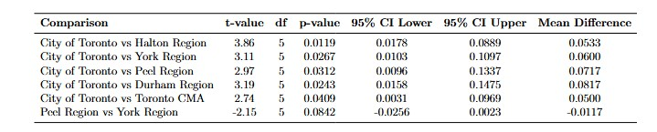
Gini Coefficient
Significant Differences in Gini Coefficients Across Regions: Paired t-tests reveal statistically significant differences in Gini coefficients between the City of Toronto and other regions, particularly Halton, York, Peel, Durham, and Toronto CMA, indicating variations in income inequality levels.
Comparison of Regional Inequality: The highest mean differences in Gini coefficients are observed between the City of Toronto and Peel/Durham Regions, suggesting these areas exhibit distinct patterns of income inequality relative to Toronto.
Source: Income Inequality

Slide 21
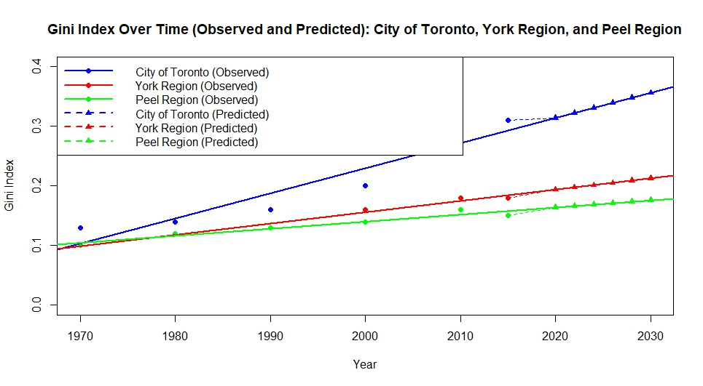
Gini Index prediction
Rising Inequality Trends: Predictive modeling shows an increasing trend in Gini Index values for the City of Toronto, York Region, and Peel Region through 2050, indicating growing income inequality.
Regional Differences: The City of Toronto is projected to have the highest Gini Index by 2030 (0.3316), suggesting more pronounced inequality compared to York and Peel Regions.
Source: Income Inequality

Slide 22
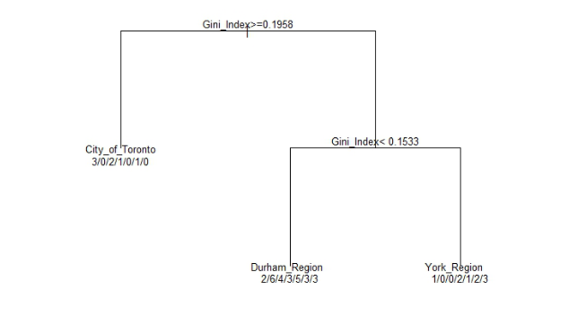
Gini Index Decision Tree
Decision Tree for Gini Index Classification: The model splits regions based on Gini Index thresholds, highlighting income inequality differences.
Distinct Regional Groupings: City of Toronto shows the highest inequality (Gini ≥ 0.1958), while Durham and York Regions are grouped with lower Gini values (Gini < 0.1533), indicating relatively less inequality.
Source: Income Inequality

Slide 23
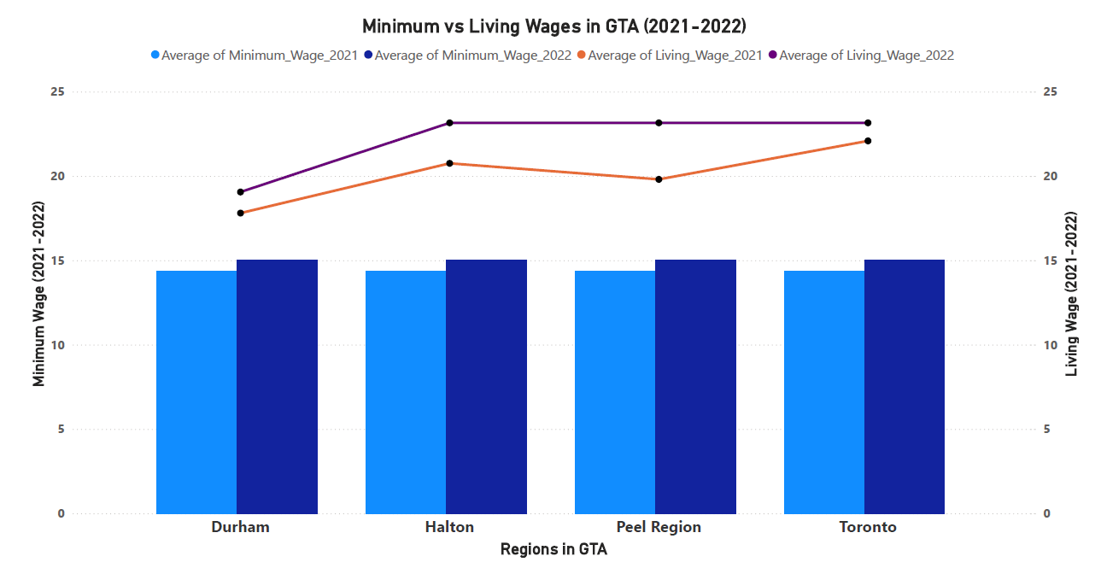
Minimum vs Living Wages in GTA (2021-2022)
The minimum wage in the GTA regions ranges from $14.35 to $15.50 per hour in 2021-2022, while the living wage, which is the hourly rate needed to cover the basic expenses of a family, ranges from $18.60 to $22.08 per hour.
The living wage is significantly higher than the minimum wage, indicating that many workers in the GTA may struggle to make ends meet, even when employed.
The difference between the minimum and living wages is largest in the Peel region, where the living wage is $22.08 per hour, compared to the minimum wage of $14.35 per hour.
Sources: 2021, 2022 Living Wages
2021 - 2022 Minimum Wages

Slide 24
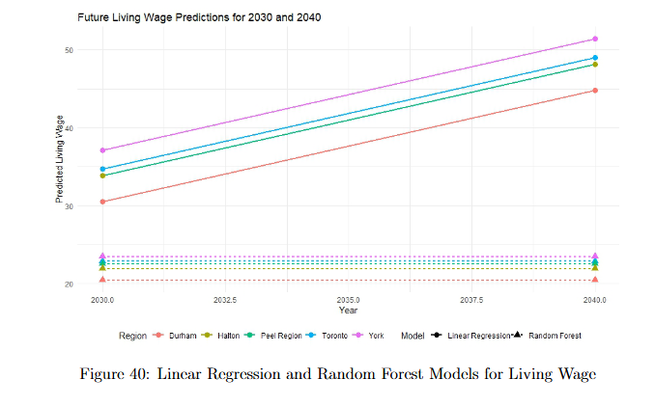
Living Wage Prediction
Living Wage Predictions for 2030 and 2040: Both linear regression and random forest models indicate rising living wage requirements across regions, with York and Toronto projected to have the highest increases.
Model Comparison: Linear regression provides a smooth trend for future wages, while random forest predictions remain consistent across years, reflecting model differences in handling linear trends.
Source: Minimum wages and Living wages

Slide 25
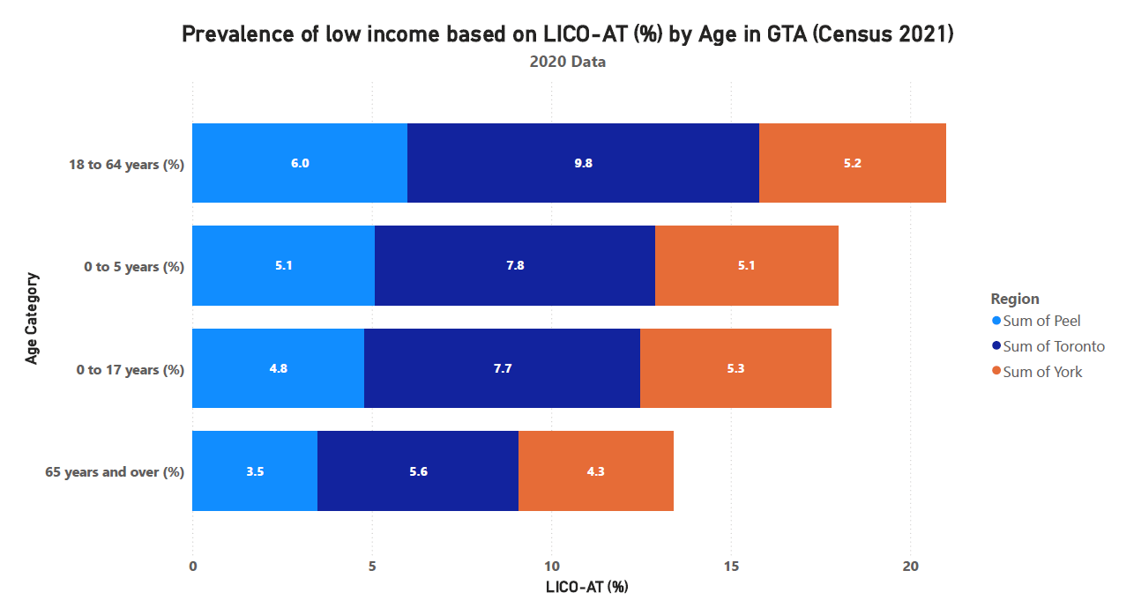
Prevalence of Low Income Based on LICO-AT (%)
The data shows that children and youth (0-17 years) have the highest prevalence of low income based on the LICO-AT measure, ranging from 7.7% in York to 9.8% in Peel.
This suggests that families with children in the GTA are disproportionately affected by low income, which can have significant impacts on child development and well-being.
The lower rates for the 18-64 and 65+ age groups indicate that government programs and policies may be more effective at supporting these demographics, but there is still room for improvement in reducing low-income levels across all age groups.
Source: LICO-AT (Census 2021)

Slide 26
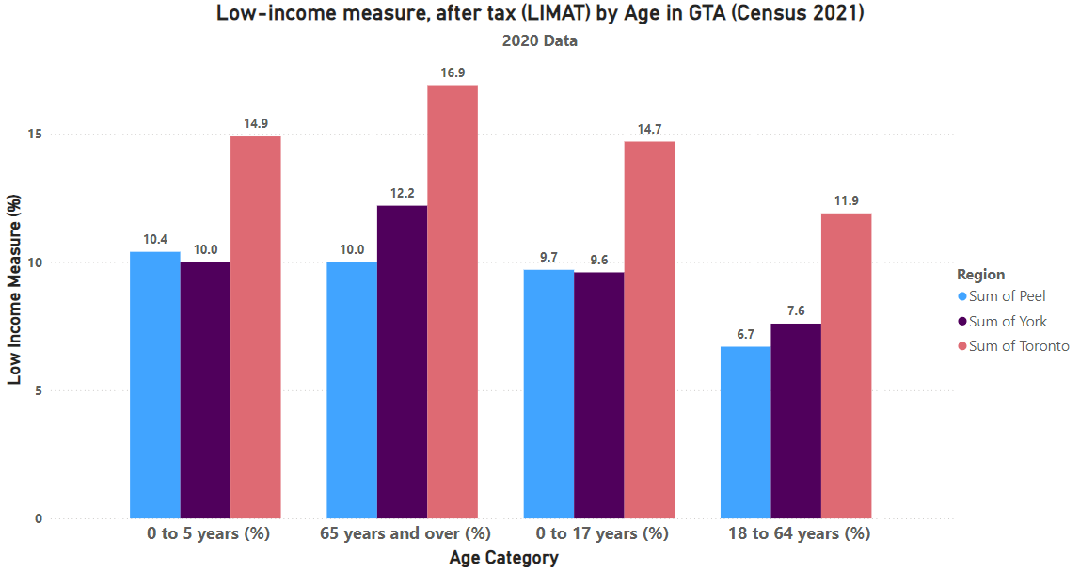
Low-Income Measure, After Tax (LIMAT) by Age in GTA (Census 2021)
The LIMAT rates are even higher than the LICO-AT rates, highlighting the significant challenge of low income in the GTA, especially for young children.
The LIMAT rate for the 0-5 years age group is over 14% in all three regions, reaching nearly 17% in Toronto, demonstrating the disproportionate burden of poverty on the youngest members of the population.
The lower LIMAT rates for the 18-64 and 65+ age groups suggest that government income support programs may be more effective for these demographics, but there is still a need to address the high levels of low income among children and youth.
Source: LIM-AT (Census 2021)

Slide 27
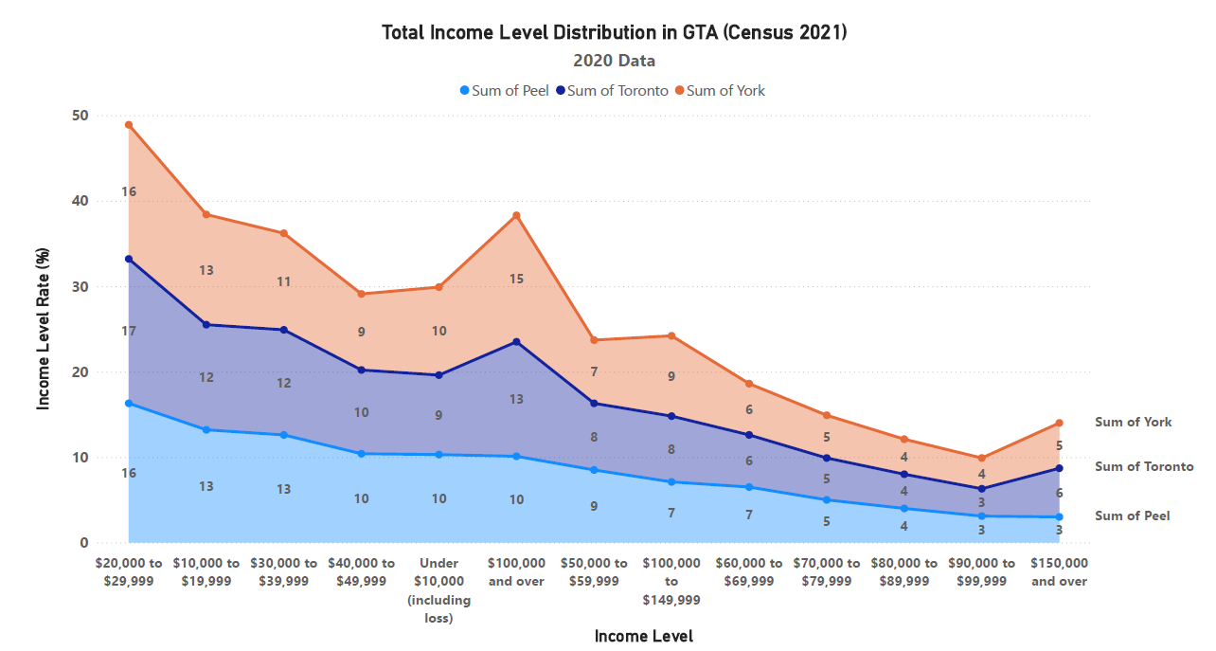
Total Income Levels in GTA (Census 2021)
The total income data shows a similar pattern, with the largest proportion of households (13-17%) earning $50,000 to $59,999.
The proportion of households with total incomes under $10,000 (including losses) is lower than the after-tax income distribution, ranging from 6-10%.
Again, York has a higher proportion of households earning $100,000 and over (17%) compared to Peel and Toronto (13-15%), indicating greater income disparity.
Source: Income Levels 2020

Slide 28
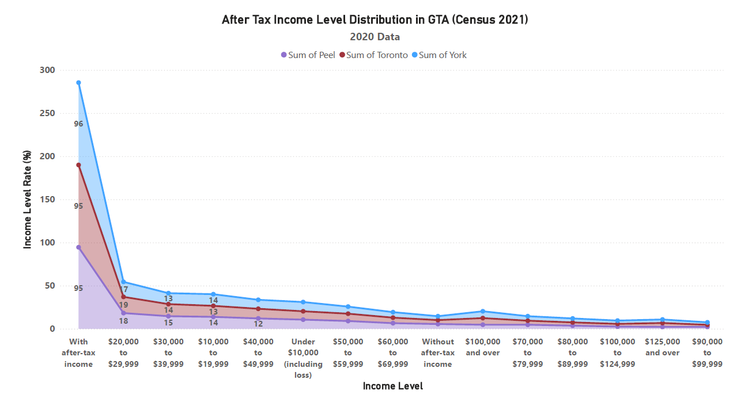
After-Tax Income Levels in GTA (Census 2021)
The data shows a concentration of households in the middle-income brackets, with the largest proportion (around 18%) earning $50,000 to $59,999 in after-tax income.
However, a significant portion of households (12-15%) have after-tax incomes under $10,000, including losses, indicating a sizable low-income population in the GTA.
The higher proportion of households earning $100,000 and over in York (19%) compared to Peel and Toronto (13-14%) suggests greater income inequality across the regions.
Source: After Tax Income Level Rates

Slide 29
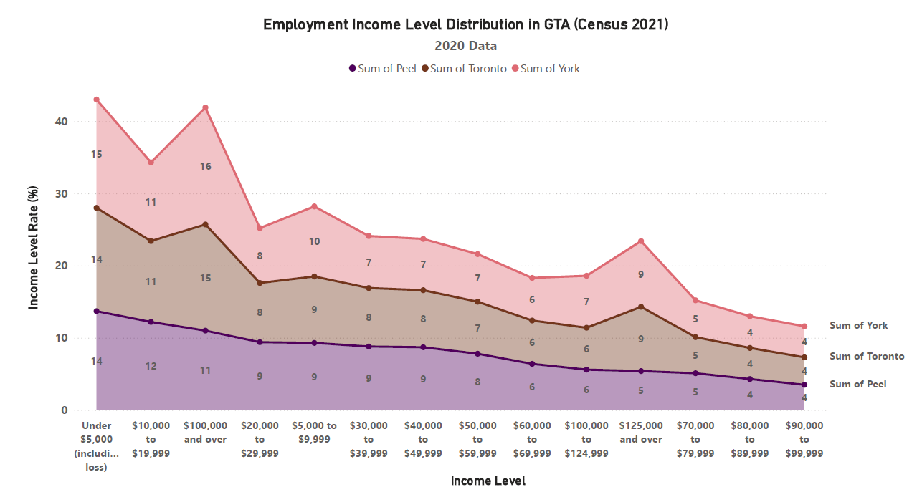
Employment Income Levels in GTA (Census 2021)
The employment income data reveals a concentration of individuals in the $30,000 to $39,999 income range, accounting for 11-15% across the three regions.
However, a significant proportion of individuals (14-16%) have employment incomes under $5,000 (including losses), suggesting a prevalence of low-wage work in the GTA.
The higher proportion of individuals earning $100,000 and over in York (9%) compared to Peel and Toronto (6-8%) points to a more unequal distribution of high-paying jobs across the GTA.
Source: Income Levels 2020

Slide 30




Overall Income Levels in GTA (Census 2021)
The income level distributions across the GTA show a mixed picture, with a concentration of households and individuals in the middle-income brackets, a sizable low-income population, and a smaller high-income group.
Income inequality is a significant issue in the region, with York generally having a higher proportion of high-income households and individuals compared to Peel and Toronto, indicating a need for policies and programs to address challenges faced by both low-income and middle-income segments.
The data suggests a prevalence of low-wage work in the GTA, with 14-16% of individuals earning under $5,000 from employment.
The unemployment rates in the GTA range from 12.7% to 13.9%, highlighting the economic challenges faced by many residents.

Slide 31
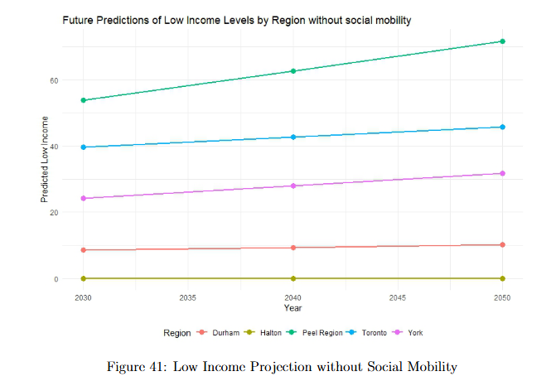
Low Income Levels Prediction
Low-Income Levels Without Social Mobility: Projections indicate rising low-income levels for Peel and Toronto, with Peel expected to reach over 60% by 2050, highlighting increasing inequality without upward mobility interventions.
Regional Disparities: York, Toronto, and Peel show significantly higher low-income projections compared to Durham and Halton, underscoring distinct regional disparities in income distribution.
Source: Low Income

Slide 32
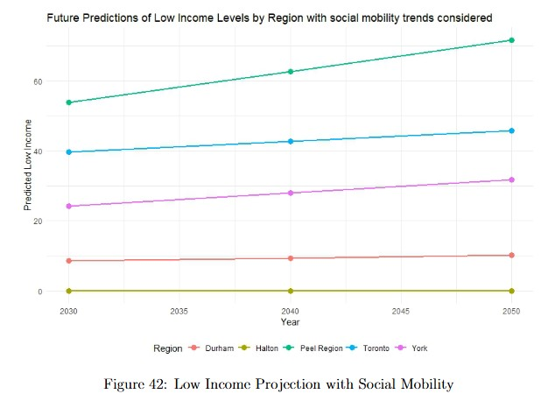
Low Income Prediction with Social Mobility considered
Social Mobility Impact on Low-Income Levels: With social mobility considered, low-income projections remain stable across most regions, with slower growth in low-income levels over time.
Regional Variations: Peel and Toronto still show the highest low-income rates by 2050, although the impact of social mobility appears to slightly reduce disparities compared to other regions.
Source: Low Income

Slide 33
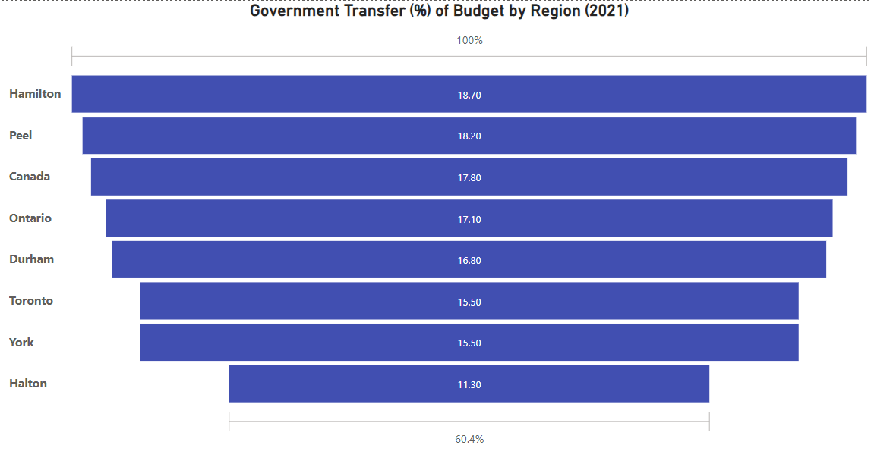
Government Transfer (%) of Budget by Region
The City of Toronto and York Region have the lowest percentage of household budgets coming from government transfers, at around 15.5%.
In contrast, Hamilton, Peel, and Durham Regions have the highest reliance on government transfers, with these transfers making up over 18% of household budgets.
The overall trend suggests that lower-income regions within the GTA and Ontario tend to have a higher dependence on government transfer payments as a source of household income.
Source: Government Transfers

Slide 34
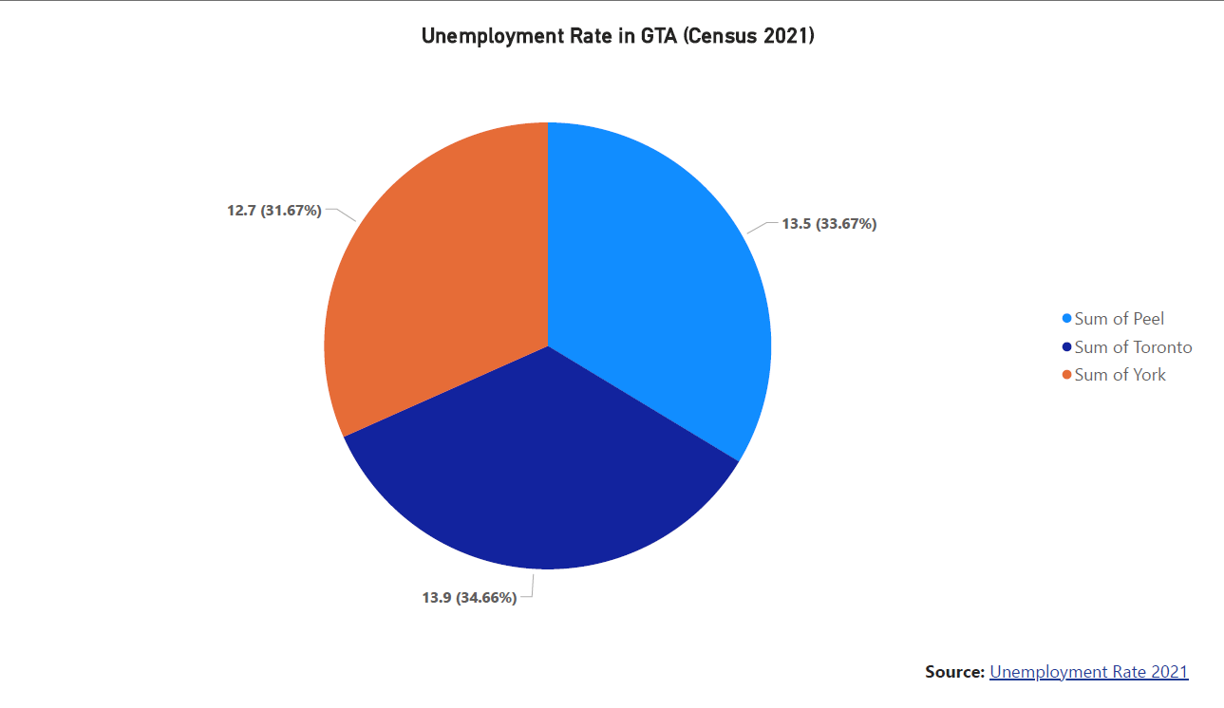
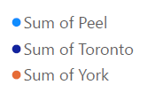
Unemployment Rate in GTA (Census 2021)
The unemployment rate is highest in Toronto at 13.9%, followed by Peel at 13.5% and York at 12.7%.
The unemployment rate in Toronto is 34.66% higher than the rate in York, indicating a significant disparity in employment opportunities across the GTA.
The high unemployment rates in the GTA, particularly in Toronto and Peel, suggest that many residents may be facing economic challenges and financial instability.
Source: Unemployment Rate 2021

Slide 35
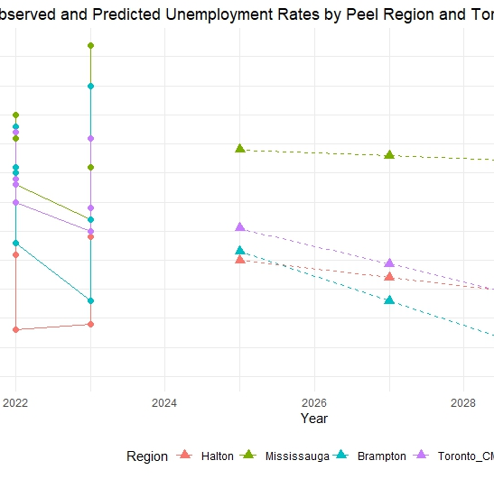
Peel Unemployment Prediction
Unemployment Rate Prediction: Future unemployment rates in Peel Region and Toronto CMA show a gradual decline from 2025 to 2050, with Toronto CMA having the lowest predicted rates across the timeline.
Model Accuracy (RMSE): Toronto CMA shows the best model fit (lowest RMSE at 0.5573), suggesting more reliable predictions for this region compared to others, such as Brampton, which has a higher RMSE.

Slide 36
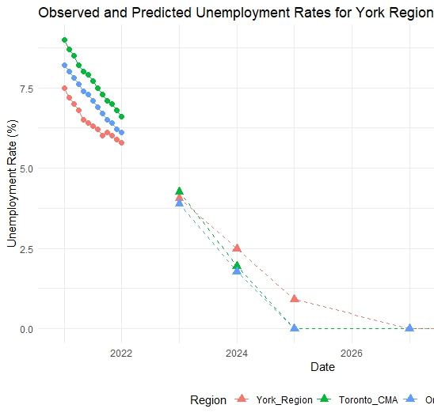
Short-Term Unemployment York
Short-Term Unemployment Forecast: Predictions for York Region, Toronto CMA, and Ontario show a steady decline in unemployment rates through 2025, indicating positive economic recovery trends.
Comparison Across Regions: York Region's unemployment rate follows a similar downward trend to Toronto CMA and Ontario, suggesting regional economic resilience.

Slide 37
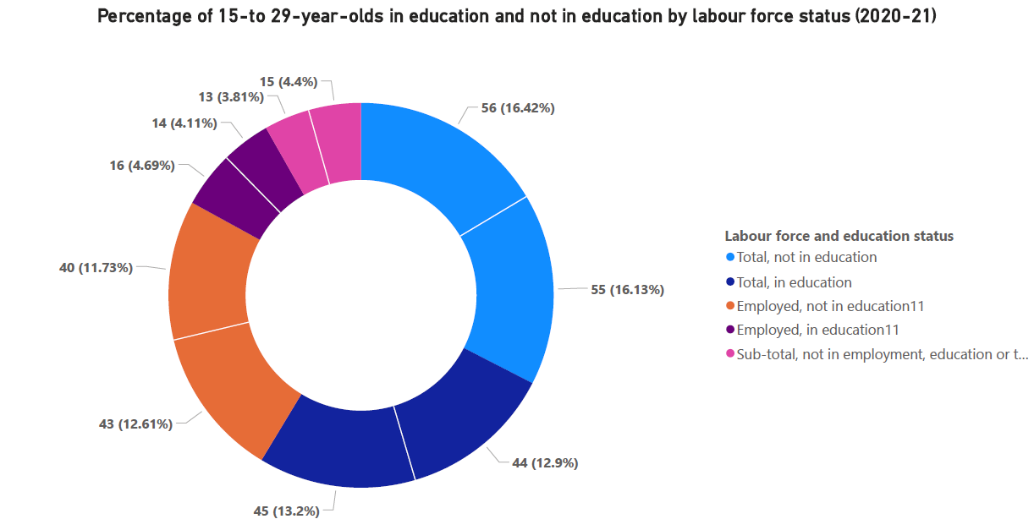
Percentage of 15-to 29-year-olds in education and not in education by labour force status (2020-21)
The proportion of 15-to 29-year-olds who are not in education and not employed (NEET) is highest in Toronto at 16.42%, followed by York at 13.2% and Peel at 12.61%.
The proportion of 15-to 29-year-olds who are employed and not in education is similar across the three regions, ranging from 11.73% in York to 13.81% in Peel.
The proportion of 15-to 29-year-olds who are employed and in education is also similar, ranging from 4.11% in York to 4.69% in Peel.
Source: NEET 2020-21

Slide 38
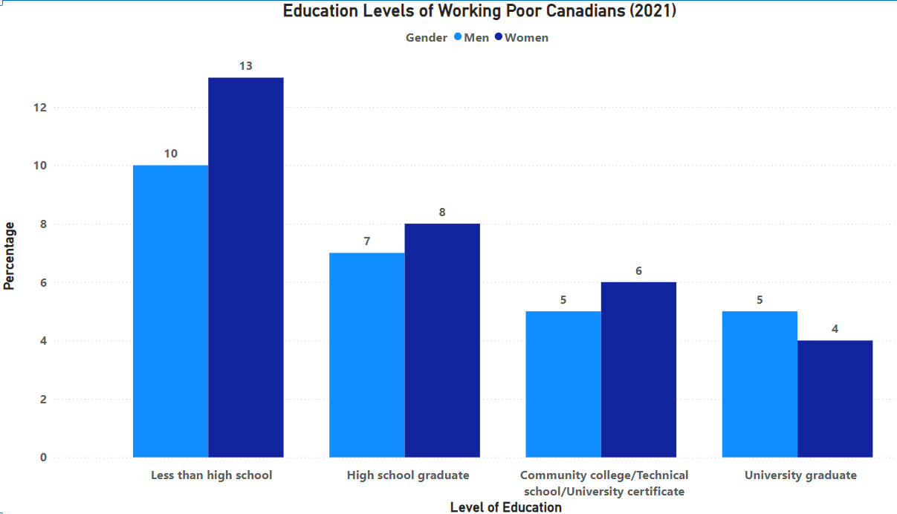
Education Levels of Working Poor Canadians (2021)
Among working poor Canadians, the largest proportion have a high school education, at 13% for men and 8% for women.
The proportion of working poor Canadians with less than a high school education is 10% for men and 7% for women.
The proportion of working poor Canadians with a university degree is 5% for both men and women, indicating that higher education does not necessarily protect against poverty.
Source: Working Poor

Slide 39
Summary of Financial Stability
Income inequality in GTA is moderate but rising, with Toronto expected to see the highest inequality by 2030.
Minimum wages fall short of living wages, leaving many workers struggling to meet basic expenses.
Projections show increasing low-income levels without social mobility interventions.
Recommendations:
Bridge the gap between minimum and living wages.
Enhance policies targeting low-income families and children.

Slide 40

Overview Of Housing
Insights into Housing Trends, Affordability, and Homelessness in the Greater Toronto Area.

Slide 41
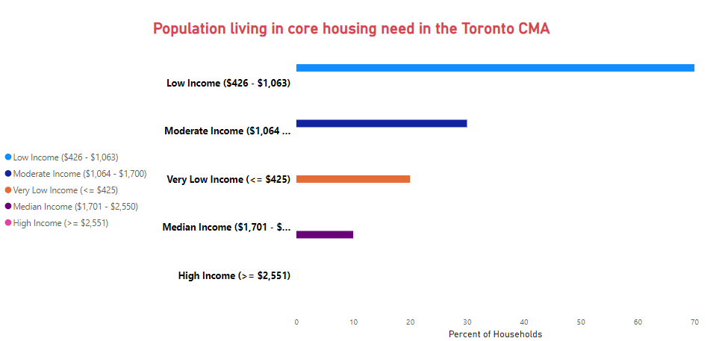
Population living in core housing need in the Toronto CMA
Core Housing Needs by Income Group: Low-income households represent the highest proportion of those experiencing core housing needs in the Toronto CMA.
Income-Based Disparities: Median and high-income groups face minimal core housing issues, highlighting stark inequalities across income levels.
Actionable Insight: Increase affordable housing stock and implement targeted support programs for low and very low-income households.
Statistics Canada. Table 46-10-0073-01 Persons in core housing need, by tenure including first-time homebuyer and social and affordable housing status, by province

Slide 42
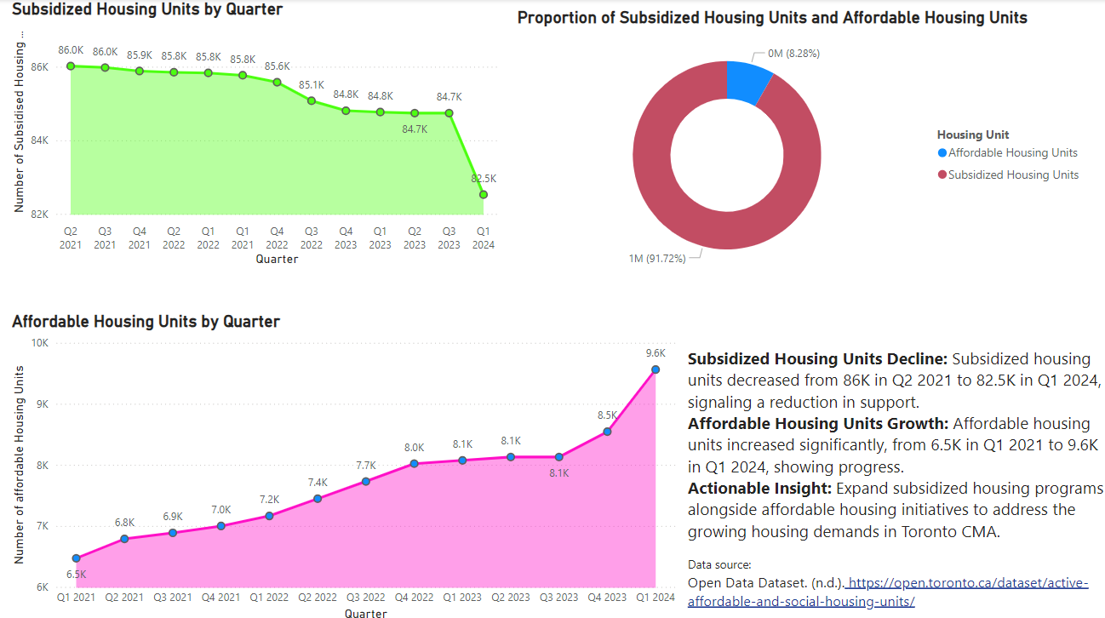
Proportion of Housing Types

Slide 43
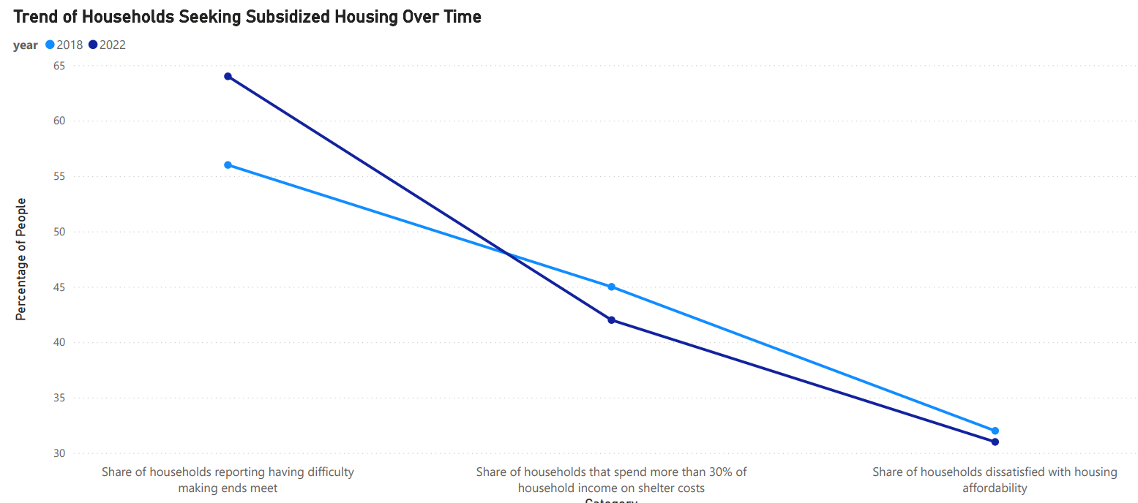
Households Seeking Subsidized Housing
A steady decline in households seeking subsidized housing was observed from 2018 to 2022.
Decreases were seen across various categories, including those struggling with affordability and high shelter costs.
The decline may indicate changes in housing conditions, reduced eligibility, or limited availability of support.
Lower demand might also suggest improvements in housing affordability, though further analysis is needed.
Understanding the reasons behind this trend is crucial for ensuring that support reaches those in need.
Source: City-Planning-2021-Census

Slide 44

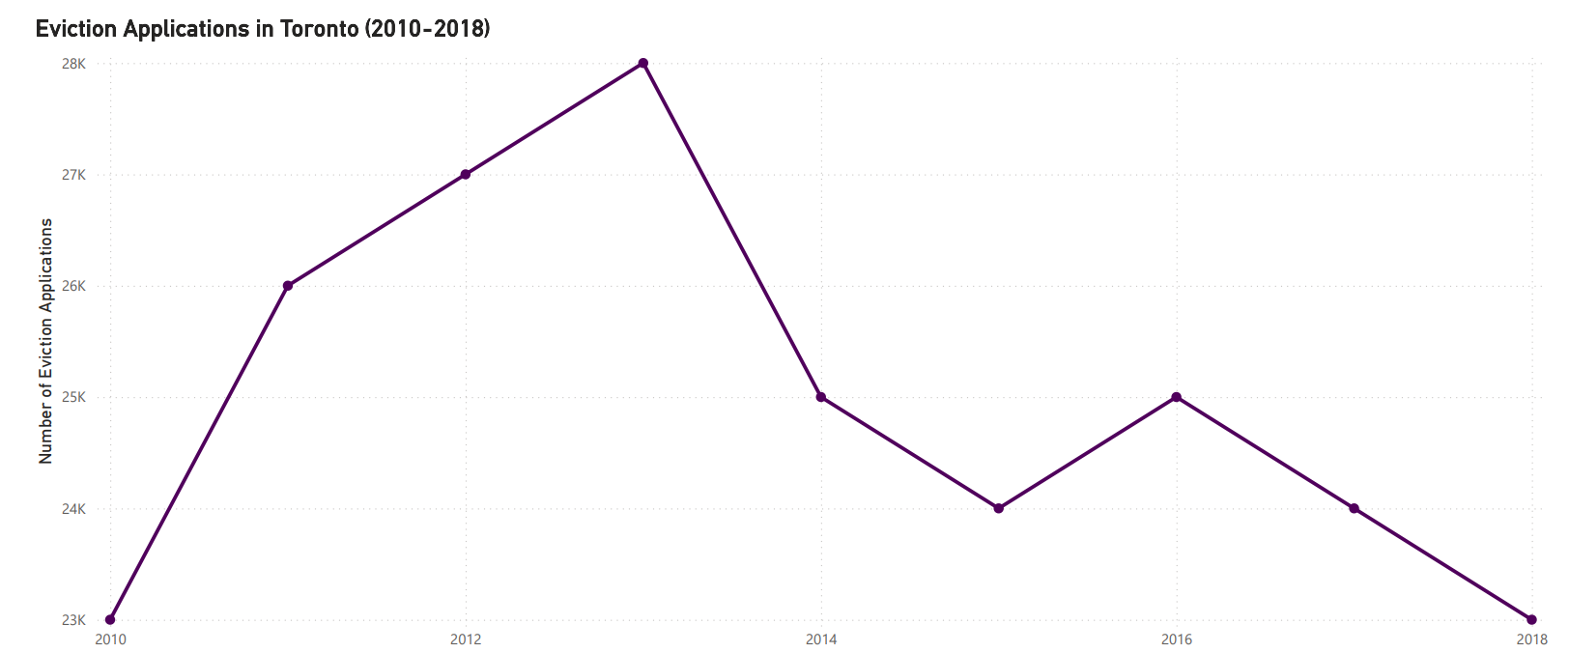




Eviction Trends in Toronto (2010-2018)
Eviction applications peaked in 2015, indicating a period of heightened housing instability.
A gradual decline in applications occurred after 2017, suggesting possible improvements in housing policies or economic conditions.
The peak period may correlate with economic downturns or increased housing costs.
The decline could reflect successful interventions like rental assistance programs or tenant support.
Understanding eviction trends is critical for developing strategies to prevent housing instability and homelessness.
Source: Eviction Applications.

Slide 45
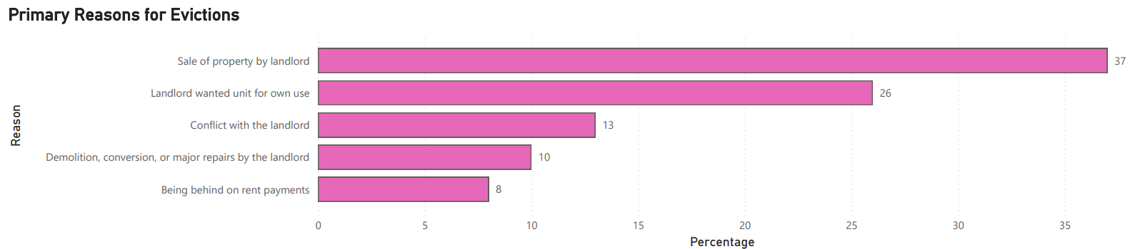
Key Drivers of Evictions
Non-payment of rent is the leading cause of evictions, highlighting economic challenges faced by tenants.
Other significant reasons include property sales and landlord-tenant disputes.
Economic stressors like job loss or rising living costs may contribute to increased non-payment cases.
The prevalence of evictions due to property sales suggests impacts from real estate market dynamics.
Understanding these drivers is essential for targeted policy interventions to reduce housing instability and prevent homelessness.
Source: Eviction Applications.

Slide 46
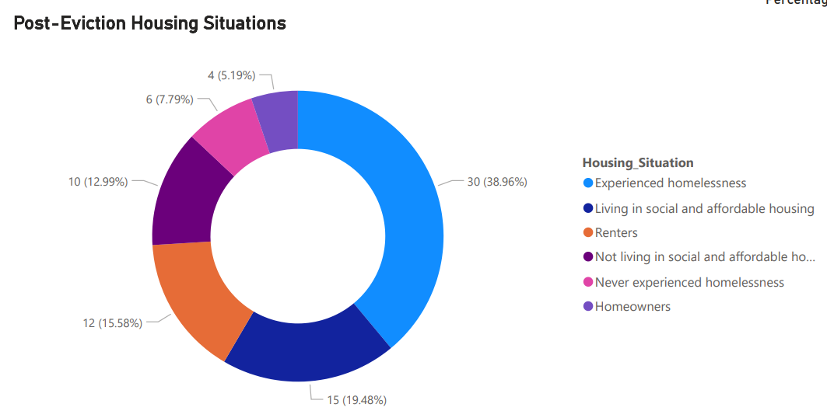
Impact on Homelessness
Many evicted individuals end up in unstable housing situations, such as shelters or living outdoors.
Post-eviction, a significant portion of people transition into temporary housing or rely on friends and family.
These transitions increase the risk of long-term homelessness without adequate support.
Addressing the root causes of eviction can reduce the strain on shelter systems.
Prevention programs and affordable housing initiatives are critical to minimizing the pathway from eviction to homelessness.
Source: Eviction Applications.

Slide 47
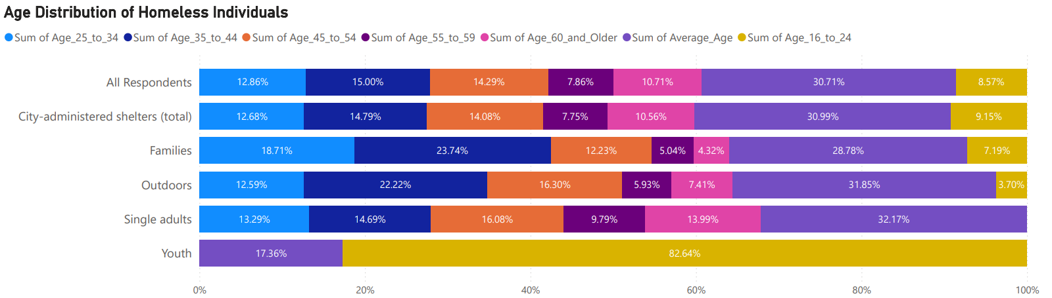
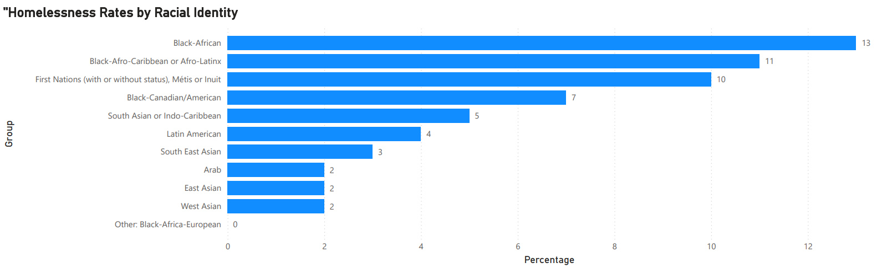
Disparities in Homelessness Rates
Indigenous and Black communities face disproportionately higher rates of homelessness.
Youth and young adults are among the most affected age groups, indicating a need for targeted support.
Systemic inequalities and historic disadvantages contribute to higher homelessness rates among marginalized groups.
Addressing these disparities requires culturally sensitive services and inclusive policy measures.
Data emphasizes the need for equity-focused approaches to reduce homelessness and provide long-term stability.
Source: Assessment data

Slide 48
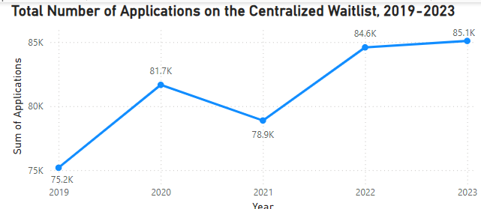
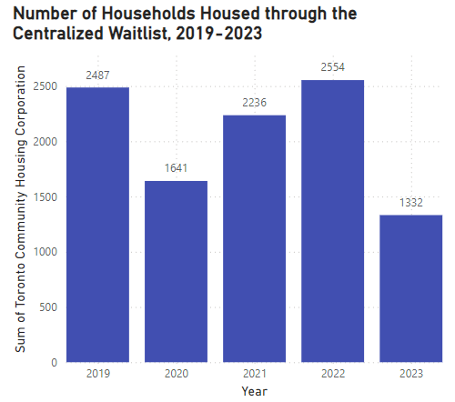
Centralized Waitlist Applications and Housing Placements (2019-2023)
The visualizations depict trends in applications and housing placements through the centralized waitlist from 2019 to 2023. Applications increased, peaking at 85.1K in 2023, while the number of housed households varied, with a notable decline in 2023. This highlights the growing demand for affordable housing and the challenges in meeting the needs of applicants.
Source: Waitlist report

Slide 49
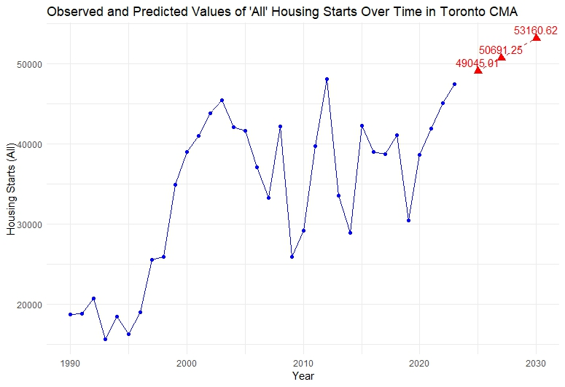
Housing Starts Predicted
Upward Trend in Housing Starts: Forecasted housing starts in Toronto CMA show steady growth, reaching approximately 69,623 units by 2050, indicating a sustained increase in construction activity.
Predictive Insight for Urban Planning: These projections can aid in urban planning by helping policymakers and stakeholders anticipate future housing supply needs and adjust infrastructure and resources accordingly.

Slide 50
Summary of Housing in Toronto (GTA)
Core housing needs predominantly affect low-income groups, highlighting stark inequalities.
Housing trends predict a steady rise in construction but show unmet demand for affordable housing.
Eviction and homelessness data stress the need for proactive intervention to minimize instability.
Recommendations:
Increase affordable housing stock.
Address eviction causes through prevention and support programs.

Slide 51
Overview of Engaged Residents
Analyzing the community engagement of individuals and trust in society and institutions.
Notes:
The community service sector plays a critical role in supporting low-income and marginalized populations by providing essential services such as housing assistance, healthcare, and social support. This project will analyze community sector support to develop a predictive model that identifies and addresses housing instability and financial hardship in the Greater Toronto Area (GTA).

Slide 52
Overview of Engaged Residents
Engaged residents play a crucial role in fostering social, economic, and institutional well-being within communities.
Resident engagement refers to the active participation of individuals in civic, social, and economic activities, including voting, volunteering, attending community meetings, and engaging with public services or local institutions.
Engaged residents contribute to stronger communities by promoting accountability, trust, and collaboration between citizens, governments, and institutions

Slide 53
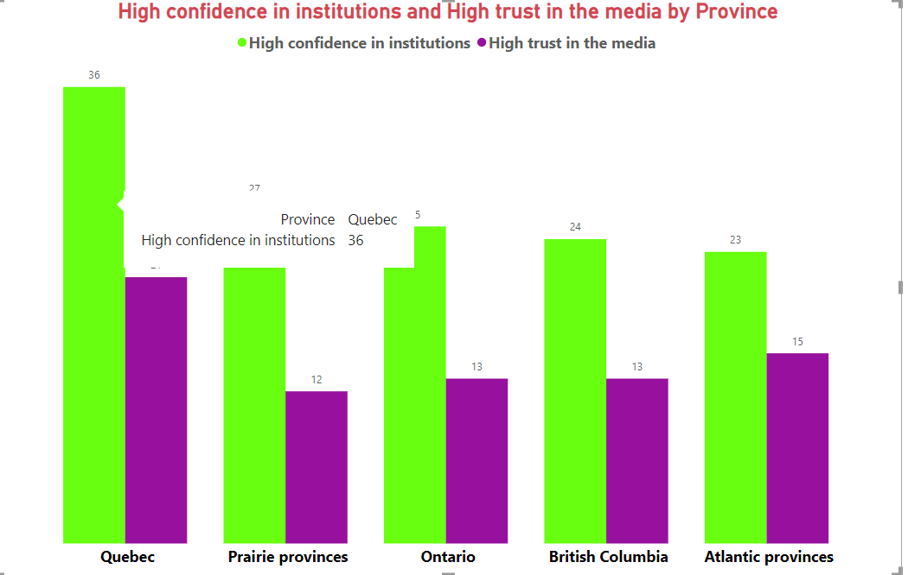
High Confidence in Institutions and Trust in the Media by Province
Observations and Trends:
Institutional Trust is Higher: In every province, confidence in institutions is higher than trust in the media
.Quebec's Exceptional Confidence: Quebec leads in both categories, with the highest levels of institutional confidence and media trust among all regions.
Media Trust is Consistently Lower: Across all provinces, media trust lags behind institutional confidence, indicating potential challenges with public perception of the media. Opportunity for Improvement in the Media Sector:
The gap between institutional confidence and media trust suggests an opportunity to improve media reliability and public perception in these regions
Source Canadian social survey

Slide 54
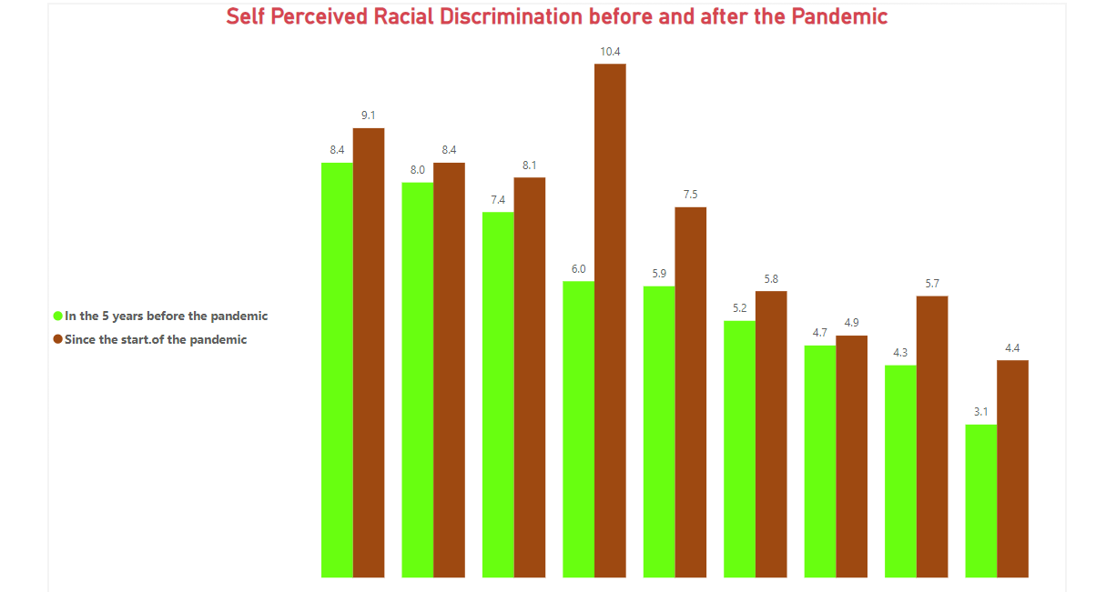
Summary of Self-Perceived Racial Discrimination Before and After the Pandemic
Increase Across All Groups: Perceived racial discrimination increased in every group since the start of the pandemic.
Significant Spikes: The highest increase was from 6.0% to 10.4%, indicating a marked rise in bias during the pandemic.
Moderate to Small Increases: Even lower initial levels showed consistent growth, such as from 4.7% to 5.8% and 3.1% to 4.4%.Pandemic Impact:
The results suggest that the pandemic heightened social tensions, warranting further research and targeted anti-discrimination interventions.
Source Canadian social survey

Slide 55
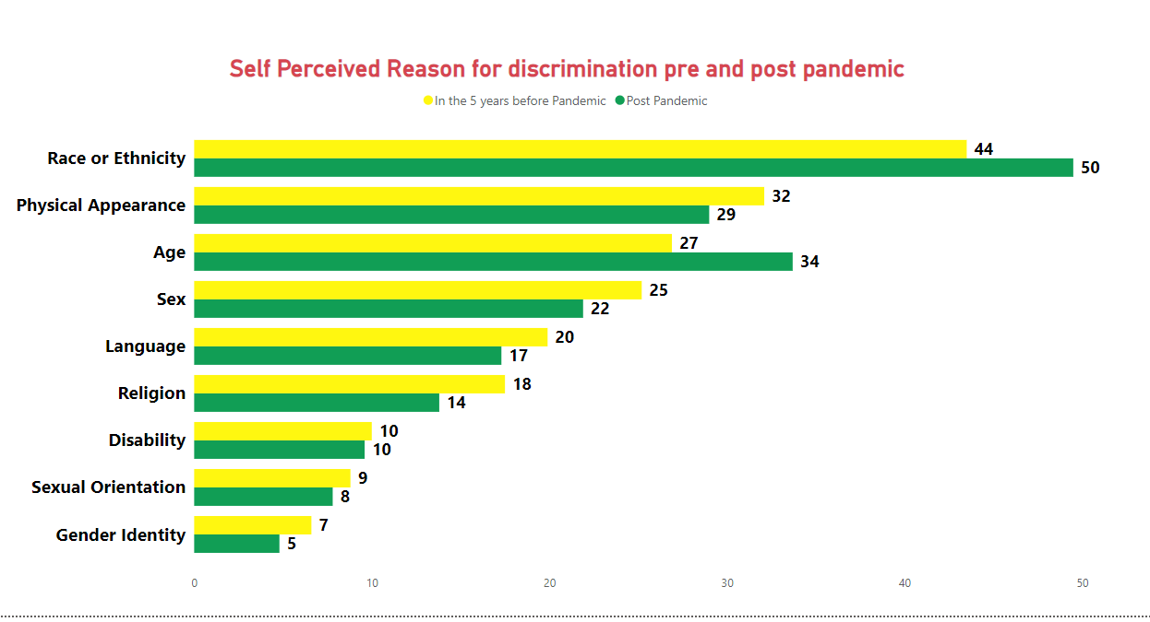
Self-Perceived Reasons for Discrimination Pre and Post Pandemic
Increase in Race or Ethnicity-Based Discrimination: Reports of discrimination based on race or ethnicity rose from 44% before the pandemic to 50% post-pandemic, indicating that race-based prejudice intensified during the pandemic.
Growth in Age and Physical Appearance Discrimination: Age-based discrimination increased from 27% to 34%, and physical appearance-related discrimination rose from 29% to 32%, suggesting that societal biases towards appearance and age became more pronounced after the pandemic began.
Consistency in Disability and Gender Identity Discrimination throughout is notice worthy.
Source Canadian social survey

Slide 56
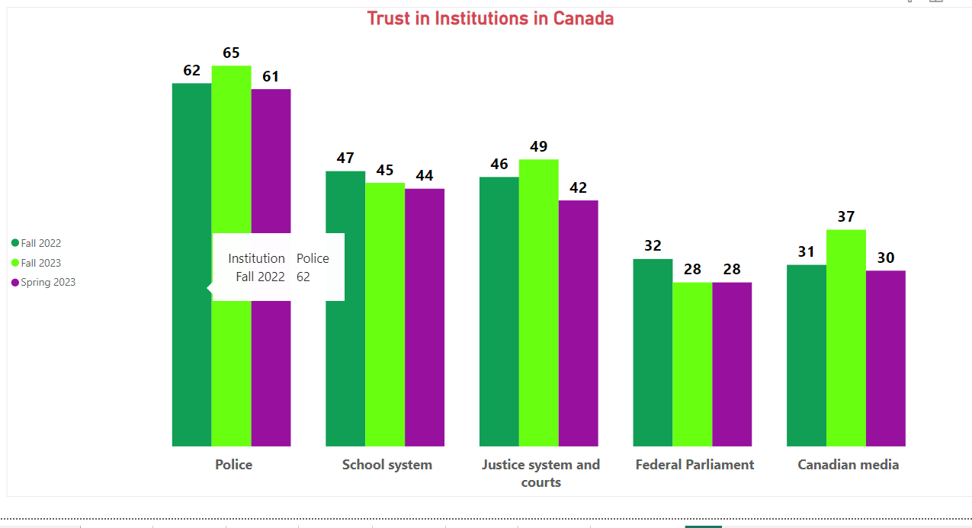
Trust in Institutions in Canada (Fall 2022 – Spring 2023)
Decline in Trust Across Institutions: Trust in key institutions, including the police, school system, and justice system and courts, has declined steadily from Fall 2022 to Spring 2023, with police seeing a drop from 65% to 61% in trust.
Justice System and Courts Notably Affected: Trust in the justice system and courts dropped from 49% in Fall 2022 to 42% in Spring 2023.
Federal Parliament and Media Maintain Low Trust Levels: Trust in Federal Parliament and Canadian media remains consistently low, with both showing slight drops between Fall 2022 and Spring 2023, highlighting persistent public skepticism toward these sectors..
Source Statistics Canada. (2023). Financial resilience and financial well-being in Canada: Highlights from the 2021 Canadian Financial Capability Survey

Slide 57
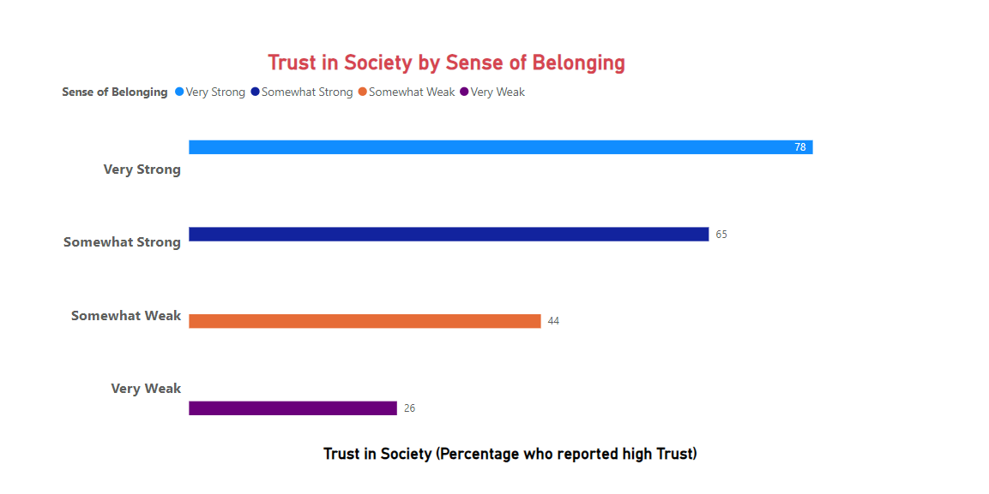
Trust in Society by Sense of Belonging
Higher Sense of Belonging Increases Trust: Individuals with a very strong sense of belonging report the highest level of trust in society, with 78% expressing high trust.
Moderate Belonging Shows Decline in Trust: Those with a somewhat strong sense of belonging still exhibit relatively high trust (65%), but the percentage decreases as the sense of belonging weakens further. weak Belonging Correlates with Low Trust: The lowest trust levels are reported by individuals with a very
weak sense of belonging (only 26%), indicating that trust in society diminishes significantly when people feel disconnected.
Source Trust in Neighbors

Slide 58
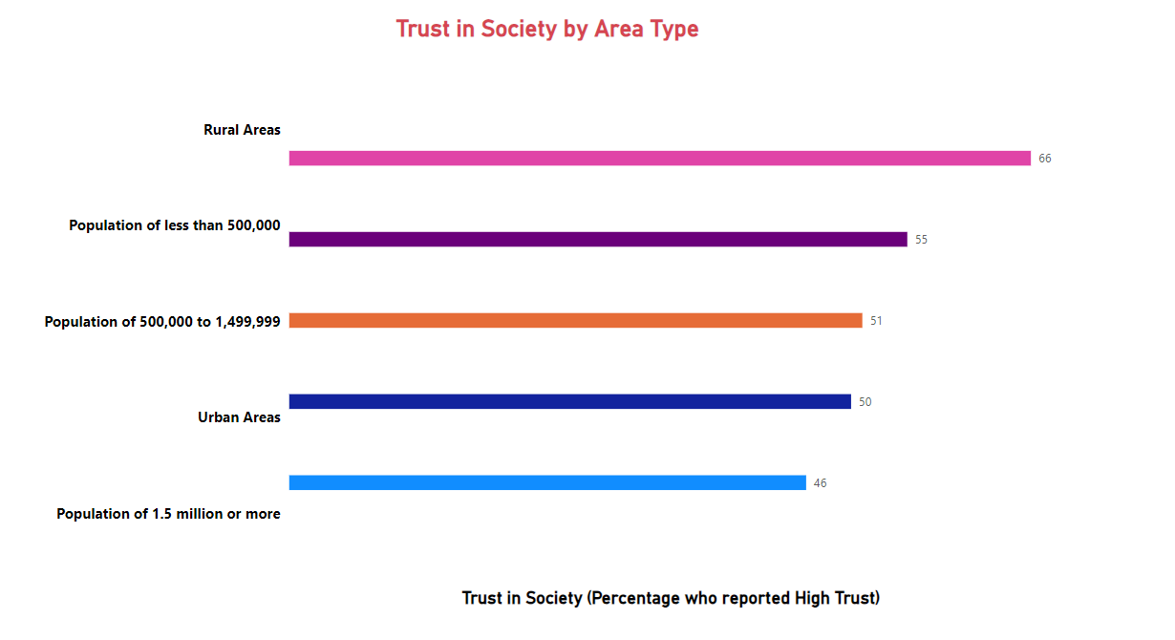
Relationship Between Trust in Society and Sense of Belonging
Stronger Sense of Belonging Increases Trust: Individuals with a very strong sense of belonging exhibit the highest trust in society, with 78% reporting high trust.
Moderate Belonging Still Maintains Trust: A somewhat strong sense of belonging corresponds to 65% reporting high trust, showing a steady but reduced level of societal trust.
Weaker Sense of Belonging Erodes Trust: Trust drops sharply among individuals with a somewhat weak (44%) and very weak (26%) sense of belonging, underscoring the impact of social connectedness on trust.
Source Trust in Neighbors

Slide 59
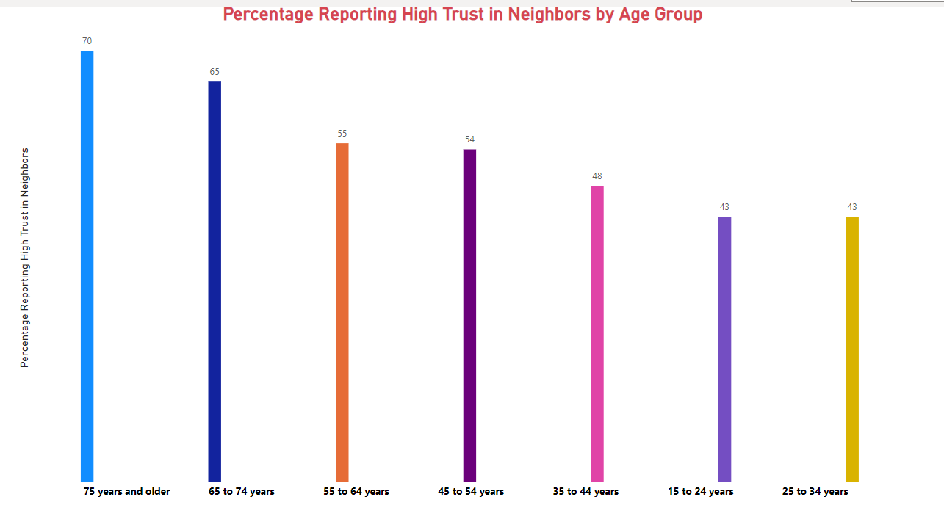
Relationship Between Trust in Society and Sense of Belonging
Older Adults Report Higher Trust: The highest trust in neighbors is observed among those 75 years and older (70%) and 65 to 74 years (65%), suggesting that older individuals tend to feel more connected with their local communities.
Moderate Trust in Middle-Aged Groups: Individuals aged 55 to 64 years (55%) and 45 to 54 years (54%) display relatively moderate levels of trust, indicating that middle-aged groups maintain trust but at a slightly lower level compared to older adults.
Younger Age Groups Report Lower Trust: The lowest levels of trust are found among 15 to 24 years (43%) and 25 to 34 years (43%).
Source Trust in Neighbors

Slide 60

Insights on Age-Based Trust in Neighbors and Implications for Social Cohesion
Trust in Neighbors Increases with Age: Older adults, particularly those aged 65 years and above, report significantly higher trust in their neighbors. This trend suggests that with age, individuals may form stronger local connections or rely more on their community.
Midlife Stability in Trust: Middle-aged groups (45 to 64 years) exhibit moderate levels of trust, reflecting stable but slightly reduced neighborhood engagement compared to older adults.
Lower Trust Among Younger Individuals: Younger individuals (15 to 34 years) report the lowest levels of trust, possibly due to lifestyle factors such as mobility, temporary living arrangements, or limited community involvement
.Implication for Community Programs: To enhance social cohesion, efforts such as community-building initiatives and youth engagement programs could focus on increasing trust and neighborly relations, particularly targeting younger age groups

Slide 61
Summary of Engaged Residents
Trust in society correlates strongly with a sense of belonging.
Declines in trust across key institutions highlight challenges in public confidence.
Age-based trust shows older adults having higher trust levels compared to youth.
Recommendations:
Focus on initiatives fostering a sense of belonging among youth.
Enhance transparency and reliability in institutions to rebuild trust.

Slide 62
Overview of community services sector support
Analyzing the community support provided by NGOs in Ontario - critical insights into operational challenges and service impact
Notes:
The community service sector plays a critical role in supporting low-income and marginalized populations by providing essential services such as housing assistance, healthcare, and social support. This project will analyze community sector support to develop a predictive model that identifies and addresses housing instability and financial hardship in the Greater Toronto Area (GTA).

Slide 63

Operating Budget by NGOs in Ontario
The largest proportion of Ontario NGOs (about 19%) fall within the $1,000,000 to $2,999,999 operating budget range, indicating that many NGOs operate at a mid-level budget.
A significant portion of NGOs, approximately 14%, operate on a small budget (0 to $99,999), highlighting the presence of grassroots or smaller community-focused organizations.
Around 16% of NGOs have operating budgets between $3,000,000 and $10,000,000, while 10% or fewer NGOs operate with budgets exceeding $10,000,000.
Mid-sized organizations, with budgets ranging from $500,000 to $999,999 and $250,000 to $499,999, represent around 13% and 12%, respectively.
A very small percentage, around 2%, of NGOs declined to share their budget information.
Source 2023 and 2024 ONN Survey

Slide 64

Demand for services by NGOs in Ontario
The chart compares the demand for programs and services experienced by Ontario NGOs in 2023 and 2024.
In 2024, 83% of NGOs reported an increase in demand for their programs and services, a rise from 76% in 2023, indicating a growing need for NGO support across the province.
Only 11% of NGOs in 2024 reported no increase in demand, which is a decrease compared to 16% in 2023, suggesting that fewer NGOs are experiencing stable or reduced demand.
Uncertainty regarding demand remains relatively low, with 6% in 2024 being unsure about changes in demand, down from 8% in 2023.
The overall trend points to a continuing increase in the pressure on NGOs to deliver essential services, reflecting growing community needs in Ontario.
Source 2023 and 2024 ONN Survey

Slide 65

Financial Forecast of NGO’S in Ontario
Source 2023 and 2024 ONN Survey
Notes:
Sustainability for the Next 12 Months: In 2023, 57% of NGOs were confident they could sustain operations for the next 12 months or more. In 2024, this confidence slightly decreased to 54%, reflecting some growing uncertainty about long-term sustainability.
7 to 12 Months Sustainability: In 2024, 20% of NGOs expect to sustain operations for 7 to 12 months, showing an increase compared to 16% in 2023. This indicates that more organizations are now expecting a medium-term financial outlook rather than long-term sustainability.
4 to 6 Months Sustainability: NGOs able to sustain themselves for 4 to 6 months slightly increased from 11% in 2023 to 13% in 2024, indicating growing concerns about short-term financial viability.
Uncertainty: The percentage of NGOs that are uncertain about their financial sustainability dropped from 18% in 2023 to 10% in 2024, showing an improvement in clarity around financial planning.
1 to 3 Months Sustainability: The number of NGOs able to sustain operations only for 1 to 3 months remains fairly consistent, with 9% in 2024 compared to 8% in 2023, indicating ongoing financial vulnerability for some organizations.

Slide 66
Financial Forecast of NGO’S in Ontario
Sustainability for the Next 12 Months: In 2023, 57% of NGOs were confident they could sustain operations for the next 12 months or more. In 2024, this confidence slightly decreased to 54%, reflecting some growing uncertainty about long-term sustainability.
7 to 12 Months Sustainability: In 2024, 20% of NGOs expect to sustain operations for 7 to 12 months, showing an increase compared to 16% in 2023. This indicates that more organizations are now expecting a medium-term financial outlook rather than long-term sustainability.
4 to 6 Months Sustainability: NGOs able to sustain themselves for 4 to 6 months slightly increased from 11% in 2023 to 13% in 2024, indicating growing concerns about short-term financial viability.
Uncertainty: The percentage of NGOs that are uncertain about their financial sustainability dropped from 18% in 2023 to 10% in 2024, showing an improvement in clarity around financial planning.
1 to 3 Months Sustainability: The number of NGOs able to sustain operations only for 1 to 3 months remains fairly consistent, with 9% in 2024 compared to 8% in 2023, indicating ongoing financial vulnerability for some organizations.

Slide 67

Impact of shortages on Ontario NGO’s in 2022, 2033 and 2024
Source 2023 and 2024 ONN Survey

Slide 68
Shortages impact on NGOs in Ontario
Programs Scaled Back: The percentage of programs scaled back increased from 50% in 2022 to 60% in 2024, reflecting a continuous trend of NGOs reducing services due to shortages.
Increased Waitlists: The number of NGOs reporting increased waitlists grew from 20% in 2022 to 40% in 2024, indicating growing service demand combined with limited capacity to address those needs.
Programs Discontinued: Although fewer programs were discontinued in 2023 (dropping to 8% from 10% in 2022), the percentage rose again to 12% in 2024, showing that while some programs were temporarily retained, financial or staffing pressures eventually led to their termination.
Overall Trend: This visualization highlights a worsening situation for NGOs in Ontario as staffing and resource shortages force organizations to cut back on programs and create longer waitlists, reducing their ability to meet community needs.

Slide 69

NGO’s skill shortages in Ontario -2024
Source 2023 and 2024 ONN Survey

Slide 70
NGO’s skill shortages in Ontario -2024
Fundraising is the most significant skill shortage, with 42% of NGOs identifying it as a gap, indicating that many organizations are struggling to secure adequate funding to support their programs.
IT/Tech skills are also in high demand, with 34% of NGOs reporting shortages, reflecting the increasing need for digital transformation and technology expertise in NGO operations.
Other notable shortages include Grant Writing (28%), Communications (27%), Data (27%), and Human Resources (27%), all essential for effective organizational management and reporting.
Government Relations (GR) skills are lacking in 25% of NGOs, emphasizing the importance of maintaining relationships with policymakers and securing government funding.
There are shortages in Digital skills (23%), Evaluation (22%), and Volunteer Management/Coordination (22%), which are crucial for program effectiveness and efficiency.
Finance and Public Policy/Advocacy skills are each identified as gaps in 21% of NGOs, highlighting challenges in maintaining financial oversight and engaging in policy influence.
Program Design and Delivery, Senior Management, and Public Affairs each represent a 16% or lower shortage, which is relatively less significant but still crucial for leadership and service execution.
A small percentage of NGOs (16%) reported that they are not facing a skills shortage, indicating that some organizations are well-resourced in terms of skills.
Shortages in Healthcare, Nursing, PSW, and Social Workers and Educators were reported by only 2% of NGOs, possibly reflecting the specific scope of services for these organizations.

Slide 71
Summary of Community Services
NGOs in Ontario face rising demand for services, with 83% reporting increased demand in 2024.
Financial forecasts reveal challenges in funding, with a reliance on government transfers in low-income regions.
Skill shortages and staff burnout are critical concerns.
Suggestions:
Strengthen support for NGO funding and workforce development.
Improve service delivery mechanisms for underserved communities.

Slide 72

References
City of Toronto. (2021). City of Toronto 2021: Affordable Housing Deficit.
Housing Assessment Resource Tools (HART),
University of British Columbia.
Canada Mortgage and Housing Corporation. (2024). Starts and Completions Survey Methodology.
Leon, S. (2020). Forced Out: Evictions, Race, and Poverty in Toronto. Wellesley Institute.
Lewis, N., de Wolff, A., King, A., Lopes, F., & Zon, N. (2020). The Opportunity Equation:
Building Opportunity in the Face of Growing Income Inequality. Neighborhood Change Research Partnership,
University of Toronto.
Metcalf Foundation. (2015). The Working Poor in the Toronto Region:
Who they are, where they live, and how trends are changing.

Slide 73
References
Ontario Nonprofit Network (ONN). (2024, October).
2024 State of the Sector - Policy Report.
Ontario Living Wage Network. (2023). Calculation Archive.
Ontario Living Wage Network. (2019). Calculating the Living Wage: Toronto 2019.
Neighborhood Change Research Partnership. (2020).
The Opportunity Equation: Building Opportunity in the
Face of Growing Income Inequality. University of Toronto.

Slide 74
References
Statistics Canada. (2022). Study: Diverse generations of Canadians: A profile of racialized Canadians in 2016.
Statistics Canada. (2019). Portrait of Canadian Society: Canadian Social Survey, 2019 (Catalogue no. 89F0115X2019001). Ottawa, Ontario.
City of Toronto. (2022). 2021 Census Backgrounder: Families, Households, Marital Status, and Income. City Planning Division.
City of Toronto. (2021). City of Toronto 2021 Street Needs Assessment Results.
Workforce Planning Board of York Region. (2023). Local Labour Market Plan Report 2022.

Slide 75
References
Ontario Nonprofit Network. (2024). 2024 survey policy report.
open.toronto.ca/dataset/active-affordable-and-social housing-units
open.toronto.ca/dataset/short-term-rental-program-data
Toronto, C. O. (2024, October 7). Social housing waiting list reports. City of Toronto
Toronto, C. O. (2024, January 22). Shelter system flow data. City of Toronto.

Slide 76

Thank You
Heartfelt Gratitude:
A sincere thank you to Professor Jay Qi for his invaluable guidance, insightful feedback, and unwavering support throughout this project.
Appreciation to UWGT:
A special acknowledgment to United Way Greater Toronto (UWGT) for the opportunity to collaborate on this meaningful initiative and contribute to the community.

